Slide 1




Maynard H. Jackson High School (Jackson Cluster) Amended and Approved 11-18-19
District Mission & Vision
Cluster Mission & Vision
School Mission & Vision
Mission:
With a caring culture of trust and collaboration, every student will graduate ready for college and career.
Vision:
A high performing school district where students love to learn, educators inspire, families engage and the community trusts the system.
Mission:
To graduate students who are productive, caring life-long learners.
Vision:
Developing inquiry, knowledge and character: Every Student, Every Teacher, Every Leader, Every Day in collaboration with Every Stakeholder.
Mission:
To be accountable for providing a globally competitive education that empowers students to achieve academic and personal goals and to become productive, responsible citizens for the 21st Century.
Vision:
To be a school of excellence preparing ALL students to successfully live and compete in a global economy.
School Priorities
Signature Program: International Baccalaureate (IB)
Key Performance Measures
School Strategies
Increase academic, on grade-level performance as measured by on-time grade-level promotion.
Maintain and improve graduation rate > 80% in 2019 and beyond.
Progression from scoring Developing to increased Proficient and Distinguished Scores on Georgia Milestone Exams.
Increase the number of students earning 3 or higher on AP exams and 4 or higher on DP exams.
Increase the number of teachers that receive IB, gifted, and current AP certification.
Increase the percentage of students who are absent fewer than 10 days.
Decrease in suspensions for students in all subgroups.
Increase parent attendance at PTO, Academic Nights, and school-related events.
Increased student participation in extracurricular programs.
Increase in average or above average results in Georgia climate survey.
Increase number of students in each signature program of IB, AP, & dual enrollment to equitably reflect students in all subgroups.
M.H. Jackson will work to maintain:
A robust offering of AP, IB, & Dual Enrollment courses with parity for all subgroups of students.
Parity in each of the signature programs of IB, AP, and dual enrollment that is reflective of all subgroups of our school population.
High-quality teaching that provides well-defined and deliberately-designed instruction that is inquiry-based, creative, interdisciplinary, technology-rich, and student-centered.
A calendar and master schedule that optimizes opportunities for vertical teaming in an effort to provide opportunities for faculty and staff to collaborate and grow academically, personally, and professionally.
A service learning program that promotes action and involvement in the school and community, and incorporates programs such as SEL, PBIS, CAS, and No Place for Hate.
A counseling and support system which focuses on college and career and empowers students to maximize their opportunities for learning future college studies, and/or post-secondary options.
Ensure PLCs are focused on planning inquiry-based, rigorous, technology-rich, student-centered lessons and units; creating quality assessments; and using data to inform instructional decisions.
Provide daily instructional support to teachers to improve achievement levels.
Earn MYP Authorization and fully implement with fidelity across 9th and 10th grade.
Implement a master schedule that optimizes teacher collaboration and student options for course work, co-curricular activities, and development opportunities, while maintaining a rigorous course of study.
Provide remediation and enrichment based on student data, including Jaguar Learning Lab tutorial and evening school.
Improve personal, social, and academic support/counseling to meet the individual needs of students.
Uses of Flexibility/Innovation
Use of Early Release days throughout the year to allow for extended Professional Learning and collaboration.
Academic
Program
Implement an effective faculty professional learning program that provides the time and resources for teachers to grow in their knowledge of innovative, research-based pedagogy, particularly in Specially Designed Instruction, Increasing Rigor (DOK levels), inquiry-based instruction, and IB (MYP, CP, DP).
Observe teacher practice through the performance management process, including F.A.S.T. Feedback, utilizing the lens of APS’ Definitions of Teaching Excellence.
Provide the structure, support, and opportunities to build the leadership capacity of our staff
Organize staff visits to school(s) that have successfully implemented the IB.
Uses of Flexibility/Innovation
Create an educational and professional environment that will recruit and retain highly effective teachers, which includes providing the necessary professional development to enhance the quality of instruction for all teachers and students.
Talent
Management
Ensure school has the resources, budget, and flexibility to support targeted subgroups, advanced students, and robust extracurricular programs.
Strengthen relationships with colleges and universities and with partners that can provide funding, exposure and resources.
Apply for applicable grants to maximize student experiences and technology.
Leverage the IB CP to allow more students to complete one or more of the CTAE Pathways.
Build systems and resources to support IB implementation.
Build systems and resources to support college and career excitement and exposure, as well as to develop more university/college partnerships.
Create and establish resources and partnerships between the CTAE department and IB Career-Related Program.
Systems &
Resources
Build a healthy school culture & climate for students, staff, and parents.
Increase the student attendance rate.
Widen scope of parent communication.
Increase activities that all stakeholder can involve themselves in that promote MJHS cluster community.
Periodic surveys to staff, students, and parents to enhance communication and receive feedback.
Implement a rising 9th grade transition program that focuses on building culture.
Incorporate Social Emotional Learning (SEL) school-wide into instruction.
Offer school-wide Positive Behavioral Intervention and Supports (PBIS) initiatives (including incentives and results).
Uses of Flexibility/Innovation
Possible Open Campus for qualified seniors (early release based on credits)
Culture

Slide 2
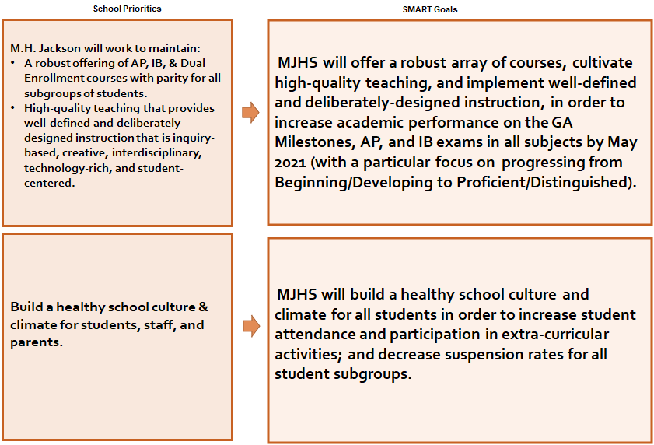
Our Priorities from Last Year.

Slide 3
FY21 School Priorities | Rationale
•A robust offering of AP, IB, & Dual Enrollment courses with parity for all subgroups of students. •High-quality teaching that provides well-defined and deliberately-designed instruction that is inquiry-based, creative, interdisciplinary, technology-rich, and student-centered. | To ensure that we have the staffing and resources that enable us to provide an instructional environment that reflects the tenets of the IB programs, which we want ingrained in all academic programs.
Build a healthy school culture & climate for students, staff, and parents. | To ensure that MJHS is a place where all stakeholders desire to come; feel safe and supported; and are offered a wide array of academic and extracurricular opportunities.
A counseling and support system which focuses on college and career and empowers students to maximize their opportunities for learning future college studies, and/or post-secondary options | To ensure that our students are supported outside of the classroom throughout their time at MJHS to increase graduation rate, scholarship dollars, college acceptances, and college readiness. This continues to be a need for our students, but we need to look closely at maximizing our budget to make this work.
Create an educational and professional environment that will recruit and retain highly effective teachers, which includes providing the necessary professional development to enhance the quality of instruction for all teachers and students; | To ensure that teachers and staff have the training ,support, and incentives to implement all programs offered at MJHS with fidelity.

